Slide 1

ML Talks – Session4
Logistic Regression

Slide 2
Introduction to Classification
Logistic Regression is another famous machine learning algorithm and it’s a statistical method to carry out classification tasks, even though the name has the term Regression in it. But before we jump into understanding Logistic Regression, lets understand what is classification.

Slide 3
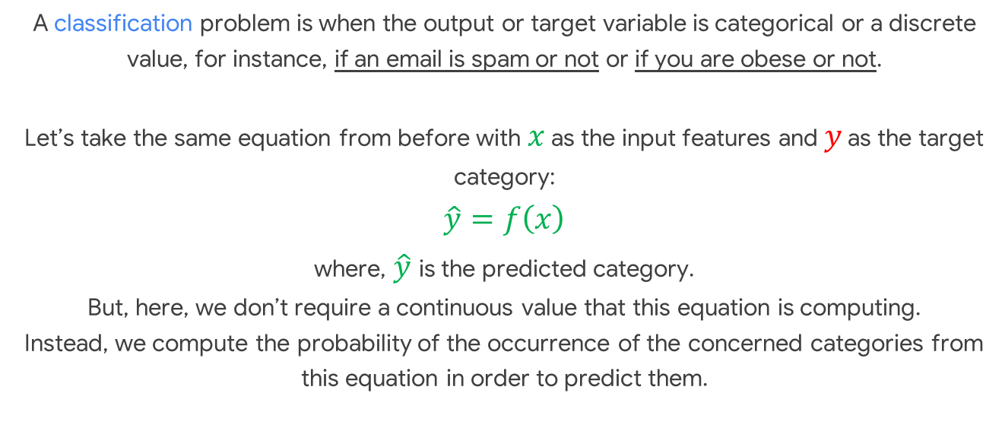
A classification problem is when the output or target variable is categorical or a discrete value, for instance, if an email is spam or not or if you are obese or not. Let’s take the same equation from before with $x$ as the input features and $y$ as the target category: $$\hat{y}=f\left(x\right)$$ where, $\hat{y}$ is the predicted category. But, here, we don’t require a continuous value that this equation is computing. Instead, we compute the probability of the occurrence of the concerned categories from this equation in order to predict them.

Slide 4
Logistic Regression
Now that we know what classification is, let’s try to understand what Logistic Regression is and it works.

Slide 5
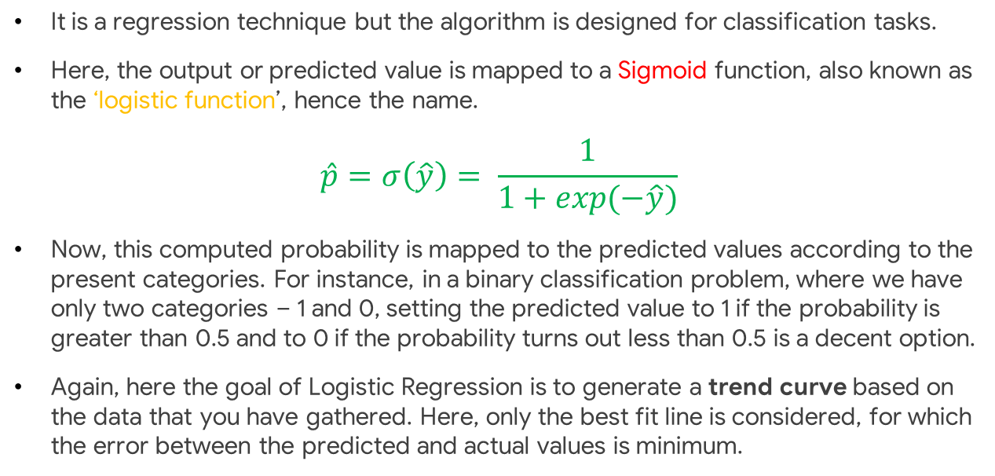
It is a regression technique but the algorithm is designed for classification tasks.
Here, the output or predicted value is mapped to a Sigmoid function, also known as the ‘logistic function’, hence the name.
$$\hat{p}=σ\left(\hat{y}\right)= \frac{1}{1+exp(−\hat{y})}$$
Now, this computed probability is mapped to the predicted values according to the present categories. For instance, in a binary classification problem, where we have only two categories – 1 and 0, setting the predicted value to 1 if the probability is greater than 0.5 and to 0 if the probability turns out less than 0.5 is a decent option.
Again, here the goal of Logistic Regression is to generate a trend curve based on the data that you have gathered. Here, only the best fit line is considered, for which the error between the predicted and actual values is minimum.

Slide 6
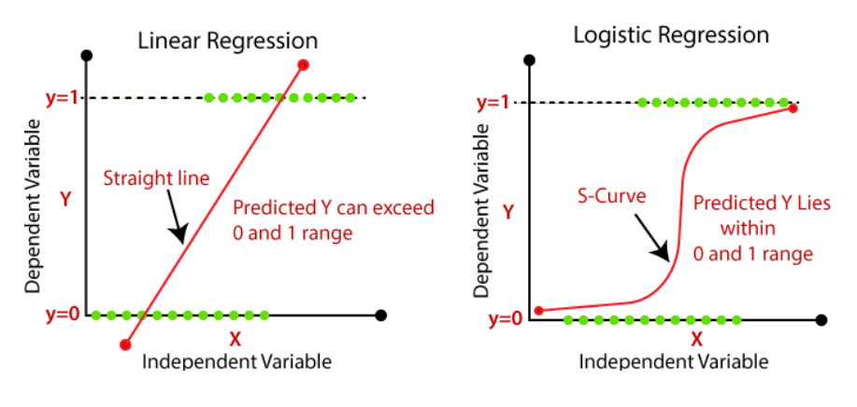
As depicted, the red line is the Trend Line and Curve we obtained and the green dots are the Data Points from which the models are supposed to learn from.

Slide 7
Installation – cmd/terminal
The latest official release of Scikit-learn can be installed using pip:
pip install scikit-learn

Slide 8
Let’s get started with some hands-on experience with Logistic Regression using scikit-learn
We’ll be using Google Colab for this.

Slide 9
Thank you!

